Slide 1
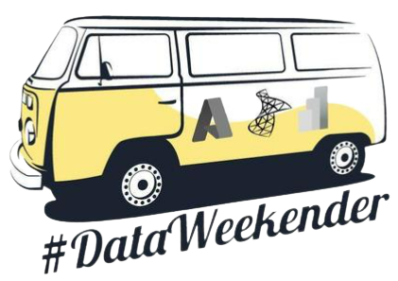
DataWeekender Cloud Challenge
Exam Cram: AI-900 Microsoft Azure AI Fundamentals
©datavibe

Slide 2








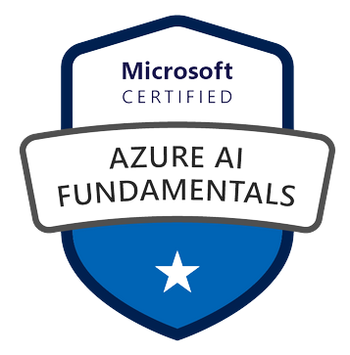
Pragati Jain
Microsoft Data Platform MVP
Superuser at Microsoft Power BI Community
10+ years of industry experience
Senior Data Analyst at Trustpilot, London
Fun Fact About Me:
I am a painter and proudly call myself ‘TechieArtist’ 😊
©datavibe

Slide 3
Agenda
Overview
What is AI-900 Exam
Who should take this exam
How to Register for the exam
Details on Exam
Exam details/content
Exam Pattern
Resources to prepare
Important topics to focus
Pattern of questions
Tips & tricks
on day before exam and
on the exam day
Next level certifications to target
©datavibe

Slide 4

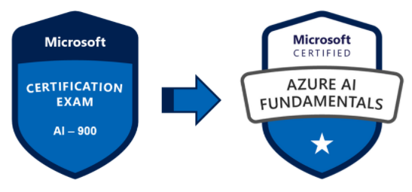
“Exam AI-900 is a Microsoft exam, that is intended towards demonstrating the knowledge around Machine Learning (ML) and Artificial Intelligence (AI) along with the basic concepts of implementing them using Microsoft Azure cloud-based solutions”
Basic concepts of ML and AI along with related Microsoft Azure services.
Relevant to candidates from both technical & non-technical backgrounds can give this exam.
AI Engineer
Data Scientist
Developer
Student
This exam is a prerequisite for becoming a Microsoft Certified in Azure AI Fundamentals.
This exam is foundation for few Azure role-based certifications: (not a prerequisite)
Azure Data Science Associate (link for exam details)
Azure AI Engineer Associate (link for exam details)
©datavibe

Slide 5

“If you are a beginner and want to learn about Machine Learning (ML) and Artificial Intelligence (AI) and how Microsoft Azure cloud services make them easier with no-code solutions, then this exam is for you”
Candidates from both technical & non-technical backgrounds can give this exam.
AI Engineer
Data Scientist
Developer
Student
Basic concepts of ML and AI along with related Microsoft Azure services is beneficial but not necessary.
©datavibe

Slide 6

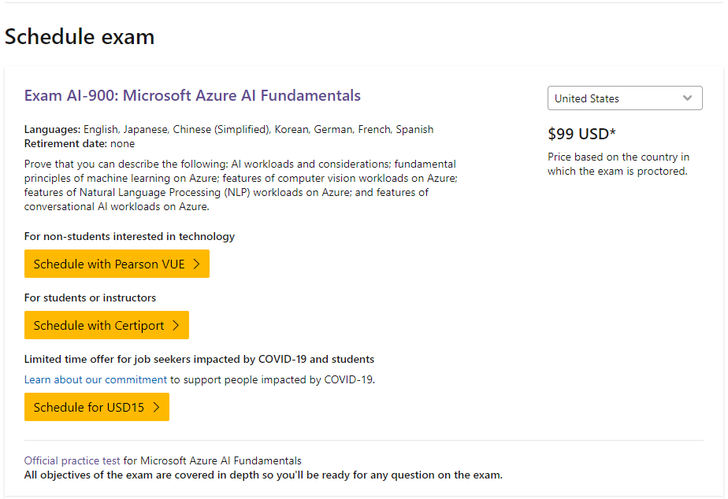
One can register for this exam from Microsoft’s official link provided on exam’s details page here.
One will need a Microsoft account before scheduling any Microsoft based exam. The account can be created here.
Once the account is created, navigate to your certification dashboard and schedule the exam. Link to the dashboard is here.
©datavibe

Slide 7

This exam measures the skills that are shown below on a high-level and the details on each of the these skills can be found here.
Describe Artificial Intelligence workloads and considerations (15-20%)
Describe fundamental principles of Machine Learning on Azure (30-35%)
Describe features of Computer Vision workloads on Azure (15-20%)
Describe features of Natural Language Processing (NLP) workloads on Azure (15-20%)
Describe features of Conversational AI workloads on Azure (15-20%)
©datavibe

Slide 8

Type of Exam Questions
Multiple choice questions
Drag & drop questions
True/False questions
Fill in the blanks questions
Question Statistics
Number of Questions: 50-53
Total Exam Duration: 90 minutes
Passing Score: 700 out of 1000
There are some un-scored questions that are asked to improve the experience with the exam. They are like feedback questions.
©datavibe

Slide 9

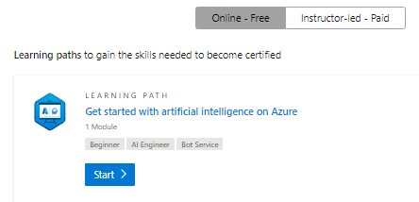
Microsoft Learn Paths
Microsoft has provided really good online learning paths for this exam and trust me they are really good and more then enough to pass this exam. These learning paths can be found here.
My Notes
While preparing for this exam I created few blogs (as part of my notes) that summarize every topic listed on this course details. The link to these blogs can be found here. These notes were very helpful one day before the exam to revise every topic in few minutes of time.
YouTube Links
John Savill – AI 900 Study Guide
A Guide to Cloud – AI 900 Study Playlist
©datavibe

Slide 10

Basic Definitions with Use-cases
Machine Learning, Anomaly Detection, Computer Vision, Custom Vision, Natural Language Processing, Conversational AI
Responsible AI Concepts (very important)
Fairness, Reliability & Safety, Privacy & Security, Inclusiveness, Transparency, Accountability
Model Creation & Deployment in Azure ML
Create Workspace, Create Compute Resources, Explore data, Train a ML model (Regression, Classification, Time series forecasting), Review Best model, deploy model as a service, clean up resources. Understand different nodes like Data connect, Select columns in Dataset, Clean Missing Data, Normalize data, Split data, Model selection, Train Model, Score Model.
Azure free subscription
©datavibe

Slide 11

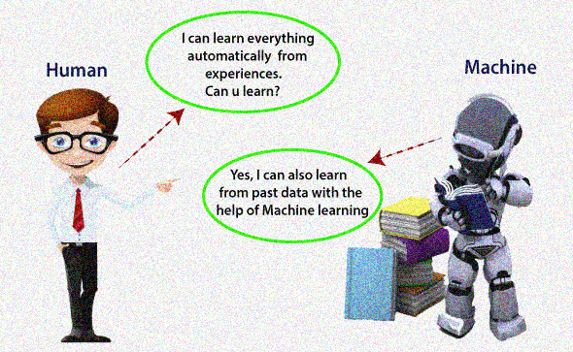

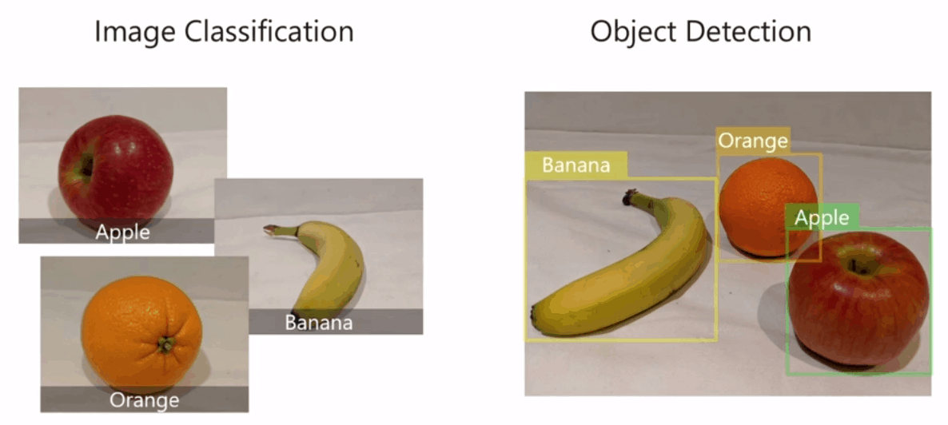
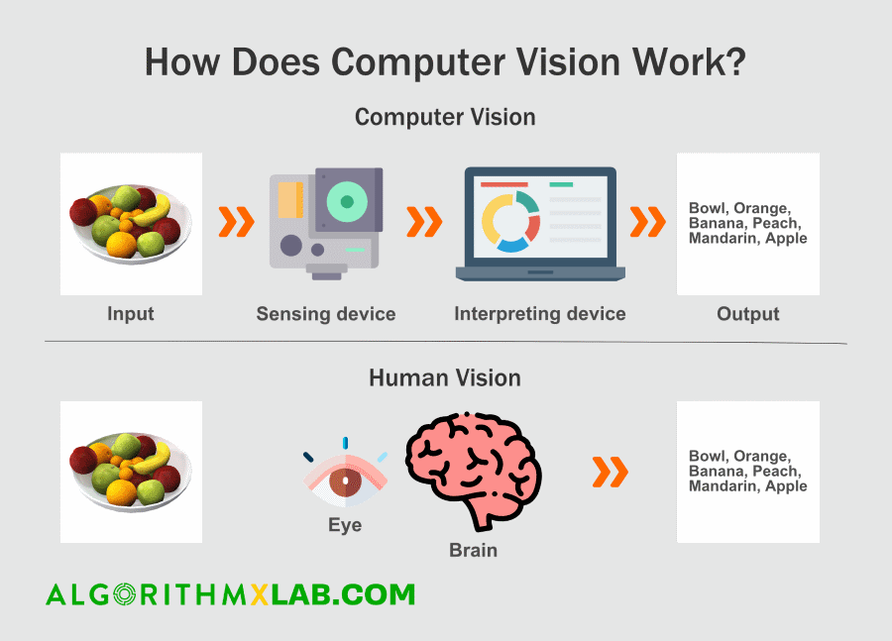
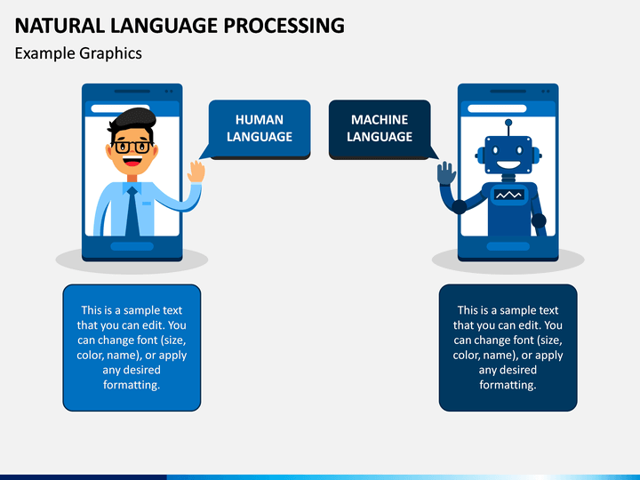

Machine Learning
Anomaly Detection
Computer Vision
Custom Vision
Natural Language Processing
Conversational AI
©datavibe
Notes:
Machine Learning – Foundation of AI, Making a machine learn from different patterns and relationships found in the data. E.g. predicting weather conditions in farming sector to predict when to plant, irrigate and harvest crops.
Anomaly Detection – ML technique to identify unusual behavior or pattern in the data. E.g. fraudulent credit card transactions.
Computer Vision – ML area when the machine deals with processing visual data like images, videos. E.g. Face detection, image classification, object identification, facial recognition, etc. Microsoft has build their own image models that can help in image classification, facial recognition, etc.
Custom Vision – ML technique used for image classification by taking custom data input on group of images. Input custom images to pre-built Microsoft models for image classification and Object detection.
Natural Language processing – An area that focuses on building a system that understands written and spoken language. E.g. understanding customer sentiments towards a brand, virtual assistants like Alexa, Siri, etc.
Conversational AI – Area of AI where AI agents communicate with humans. E.g. customer service chat where a bot or a virtual assistant is in a conversation with the customer.

Slide 12
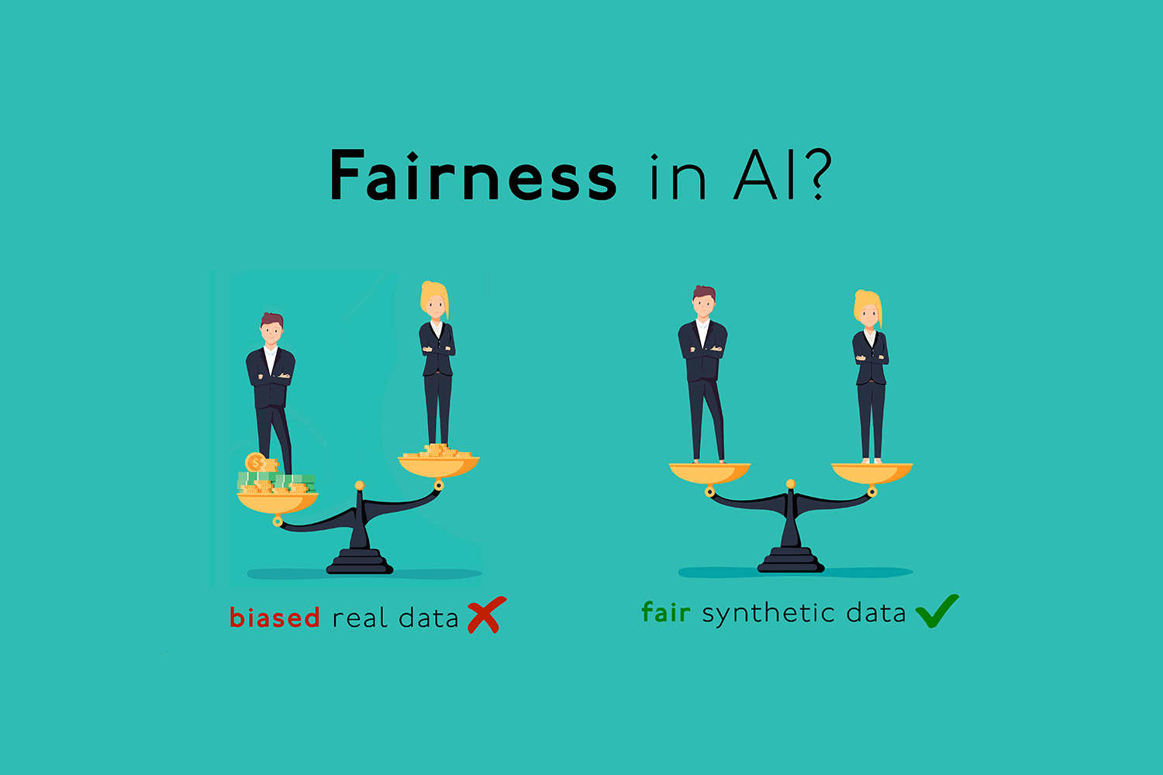

“AI is a very powerful tool that has been used in multiple fields to provide and generate beneficial solutions. But every tool or technology should always be used in a responsible manner in order to avoid any negative consequences. At Microsoft, the AI development follows six principles.”
Fairness
Reliability & Safety
“AI system should treat everything same without any bias.”
“AI systems should work reliably and safely as this may lead to negative consequences.”
©datavibe
Notes:
Fairness – AI systems should treat everything same without any bias.
Reliability & Safety – AI systems should work reliably and safely as this may lead to negative consequences.
Transparency – AI systems should be easy to understand.
Privacy & Security – AI systems should be secure and respect privacy.
Inclusiveness – AI systems should empower and engage everyone.
Accountability – AI systems should develop and work within a governed framework and be accountable.

Slide 13


Privacy & Security
Transparency
“AI system should be secure and respect privacy.”
“AI system should be easy to understand.”
©datavibe
Notes:
Fairness – AI systems should treat everything same without any bias.
Reliability & Safety – AI systems should work reliably and safely as this may lead to negative consequences.
Transparency – AI systems should be easy to understand.
Privacy & Security – AI systems should be secure and respect privacy.
Inclusiveness – AI systems should empower and engage everyone.
Accountability – AI systems should develop and work within a governed framework and be accountable.

Slide 14


Inclusiveness
Accountability
“AI systems should empower and engage everyone”
“AI systems should develop and work within a governed framework and be accountable.”
©datavibe
Notes:
Fairness – AI systems should treat everything same without any bias.
Reliability & Safety – AI systems should work reliably and safely as this may lead to negative consequences.
Transparency – AI systems should be easy to understand.
Privacy & Security – AI systems should be secure and respect privacy.
Inclusiveness – AI systems should empower and engage everyone.
Accountability – AI systems should develop and work within a governed framework and be accountable.

Slide 15
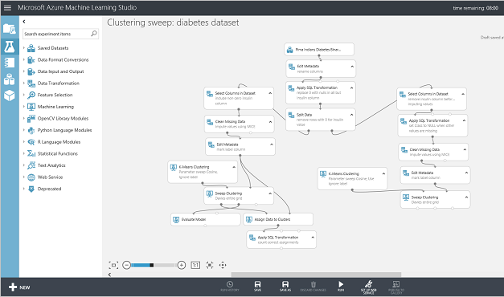
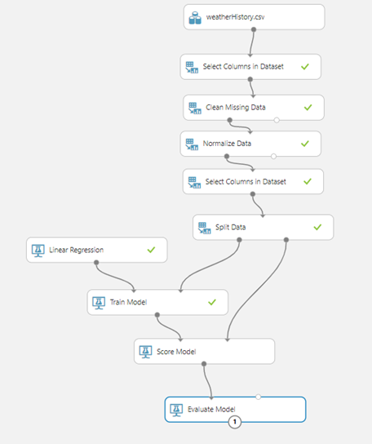
Azure Machine Learning Studio
©datavibe

Slide 16
Model Evaluation Definitions (very important)
Mean Absolute Error (MSE), Root Mean Squared Error (RMSE), Relative Squared Error (RSE), Relative Absolute Error (RAE), Coefficient of Determination (R2).
ROC curve, True/Positive rate, Confusion Matrix, Precision/Recall, Lift curves
Different ML Techniques with Examples
Supervised, Unsupervised - Regression, Classification, Clustering.
Examples in which scenarios above techniques will be used.
Other Definitions with Examples
Chatbot Service, QA Maker, Language Understanding Intelligent Service (LUIS).
Differences between Similarity, Grouping and Identification.
Speech synthesis, speech translation with examples.
Concepts of Text Analytics API – speech-to-text, text-to-speech, sentiment analysis.
©datavibe

Slide 17

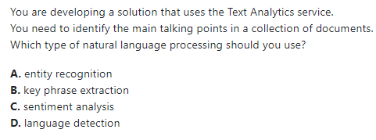
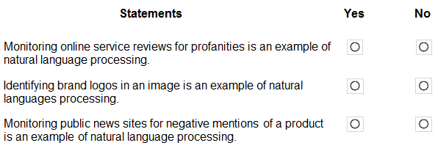
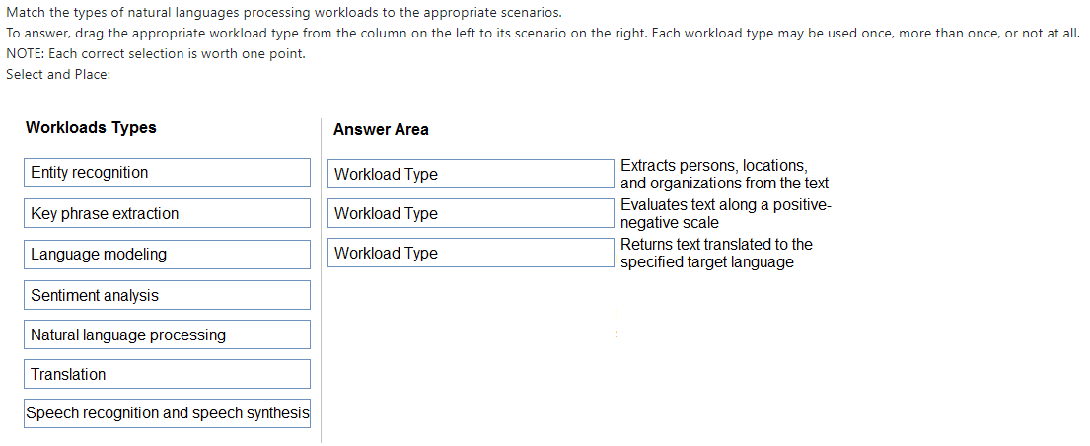
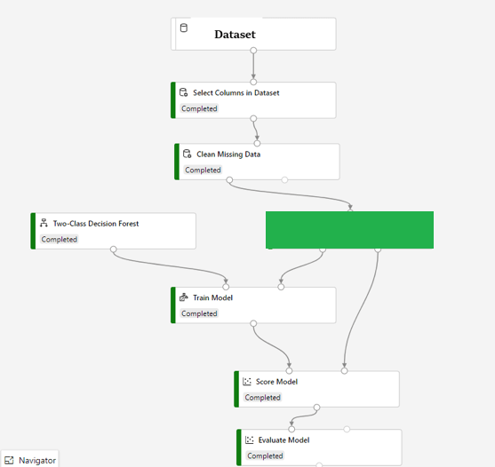
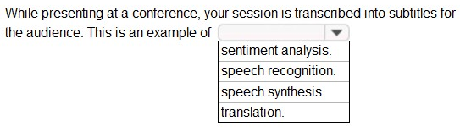
???
©datavibe

Slide 18

“One day before your exam make sure you check the email from Microsoft that lists down all the steps you need to do before the exam. The email that has your exam schedule information will have a list of steps to be done prior to the exam.”
System Test
Keep ID Ready
Revision
Make sure you have run system test on the machine that you will be using to take this exam.
As this is an online exam, you will have to verify yourself before taking the exam. Make sure you have relevant ID handy.
An invigilator will be monitoring you all through the exam.
The most important step is to Revise your notes. Make sure you do this to recall all the concepts as part of your preparation. “Revision is the Key to Success!”
Relax
Have a good sleep and relax your mind the day before your exam.
Trust your preparation.
You will also need your phone to do some initial verifications.
©datavibe

Slide 19

Tip1
Be calm and trust your preparation.
90 minutes are enough to complete this exam along with feedback questions.
Tip2
Read the questions properly.
You can always return back to the marked questions.
Tip3
Before submitting make sure to review your answers once.
Answer the ones that you are confident about first and mark the questions that you are not sure about.
©datavibe

Slide 20


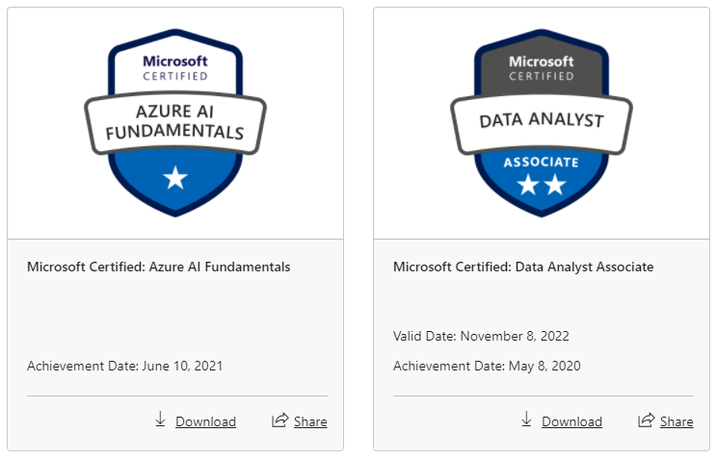
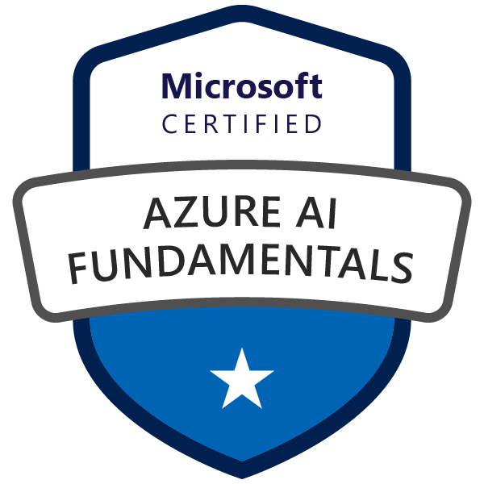
“Your score appears as soon as you complete and submit your exam. It takes sometime to appear on your Microsoft Certification Dashboard.”
“Once your badge appears on your Microsoft Certification Dashboard, you can access and download the badge from here. You can also access transcripts for your exam here.
©datavibe

Slide 21


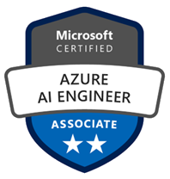
“Once you have passed Exam AI-900 and have earned your Microsoft Certification on Azure AI Fundamentals, you can plan to earn the next step certifications.”
Microsoft Certified – Azure AI Fundamentals
Azure Data Science Associate
Azure AI Engineer Associate
©datavibe

Slide 22


Good Luck for your Exam!
Thank you and Happy to answer any questions.
©datavibe

